Slide 1
PYTHON PROGRAMMING & DATA SCIENCE

Slide 2

Recurrent Neural Networks (RNN)
Recurrent Neural Networks (RNN)
A recurrent neural network (RNN) is a type of artificial neural network which uses sequential data or time series data.
Deep learning algorithms are commonly used for ordinal or temporal problems, such as language translation, natural language processing (nlp), speech recognition, and image captioning;
RNN are incorporated into popular applications such as Siri, voice search, and Google Translate.
RNNs are a powerful and robust type of neural network, and belong to the most promising algorithms in use because it is the only one with an internal memory.

Slide 3
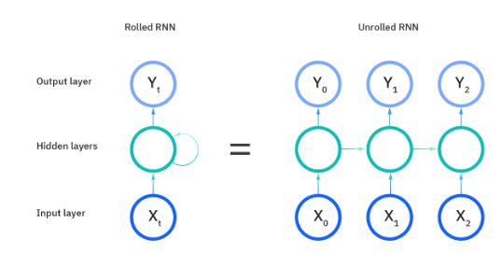
Recurrent Neural Networks (RNN)
Recurrent Neural Networks (RNN)
Recurrent neural networks utilize training data to learn.
They are distinguished by their “memory” as they take information from prior inputs to influence the current input and output.
Architecture of a traditional RNN:
Recurrent neural networks are a class of neural networks that allow previous outputs to be used as inputs while having hidden states.
They are typically as follows:

Slide 4
Recurrent Neural Networks (RNN)
How recurrent neural network works
The working of an RNN can be described with the help of the following example.
Example:
Suppose a deeper network consists of one input layer, three hidden layers, and one output layer. Then not like other neural networks, each hidden layer will have its own set of weights and their biases. The value for hidden layer is 1; then the weights and biases are w1 and b1, w2 and b2 for second hidden layer, and w3 and b3 for third hidden layer. This means that each of these layers is independent of each other, i.e., they do not memorize any other previous outputs.

Slide 5
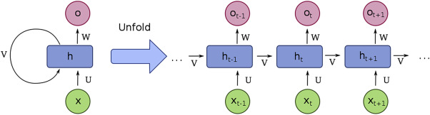
Recurrent Neural Networks (RNN)
How recurrent neural network works
The process of RNN with input and output layer is as follows.
The RNN will do the following:
RNN resolves the independent activations into dependent activations by presuming the same weights and biases to all the layers, thus minimizing the complexity of ascending parameters and memorizing each previous output by giving each output as input to the next hidden .

Slide 6
Recurrent Neural Networks (RNN)
How recurrent neural network works
Three layers can be merged together such that the weights and bias of all the hidden layers are not different.
Formula for calculating current state is defined as:
h_{t} =f(h_{t−1} , x_{t} )
where
h_{t} denotes current state
h_{t−1} denotes previous state
x_{t} denotes input state

Slide 7
Recurrent Neural Networks (RNN)
How recurrent neural network works
Formula for applying activation function (tanh) is defined as:
h_{t} =tanh(w_{hh} h_{t−1} + w_{xh} x_{t} )
Where,
w_{hh} is weight at recurrent neuron
w_{xh} is weight at input neuron
h_{t−1} denotes previous state
x_{t} denotes input state
Formula for calculating output is :
Y_{t} = W_{hy} h_{t}
Y_{t} is output
W_{hy} is weight at output layer
h_{t} denotes current state

Slide 8
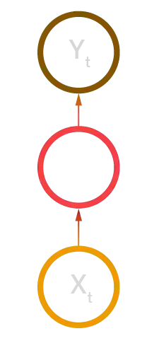
Recurrent Neural Networks (RNN)
Types of recurrent neural networks
There are mainly 4 types of RNNs. Those are :
One-to-one
One-to-many
Many-to-one
Many-to-many
One-to-one:
Example:
Traditional neural network

Slide 9
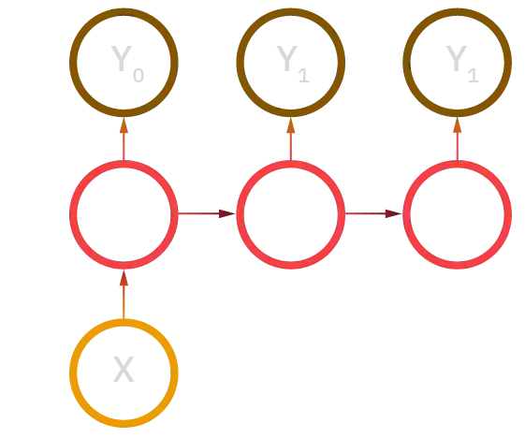
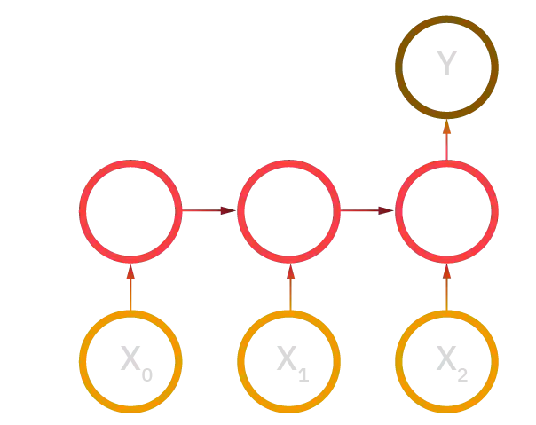
Recurrent Neural Networks (RNN)
One-to-many:
Example:
Music generation
Many-to-one:
Example:
Sentiment classification

Slide 10
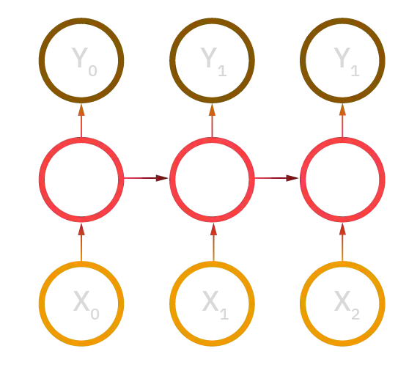
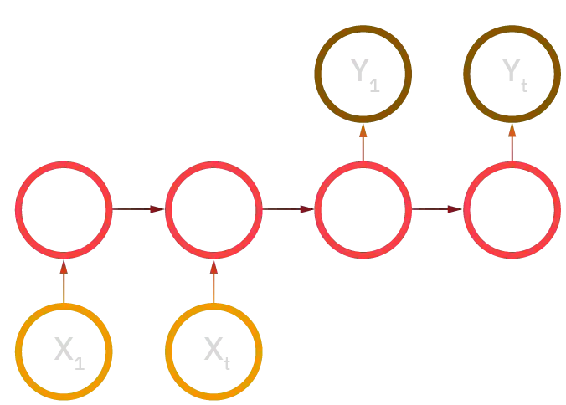
Recurrent Neural Networks (RNN)
Many-to-many:
i)
Example:
Name entity recognition
ii)
Example:
Machine translation

Slide 11
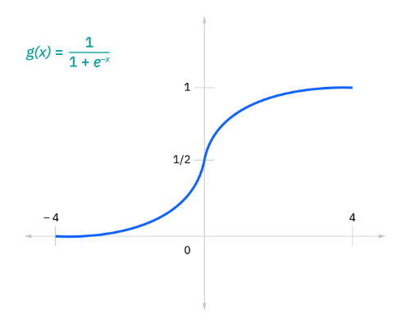
Recurrent Neural Networks (RNN)
Common activation functions
Some of the most commonly used functions are :
Sigmoid
Tanh
Relu
Sigmoid:
This is represented with the formula
g(x) = 1/(1 + e^-x).

Slide 12
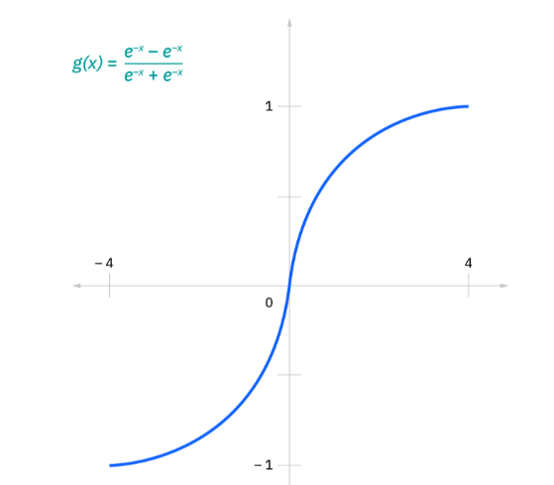
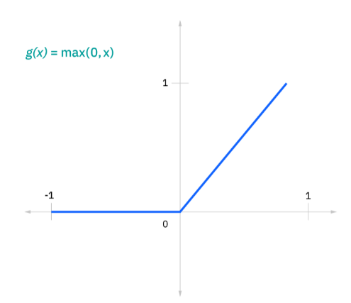
Recurrent Neural Networks (RNN)
Tanh:
This is represented with the formula
g(x) = (e^-x - e^-x)/(e^-x + e^-x).
Relu:
This is represented with the formula
g(x) = max(0 , x)

Slide 13
Recurrent Neural Networks (RNN)
Variant RNN architectures:
Variant RNN architectures are:
Bidirectional recurrent neural networks (BRNN)
Long short-term memory (LSTM)
Gated recurrent units (GRUs)
Bidirectional recurrent neural networks (BRNN):
Bidirectional recurrent neural networks (BRNNs) are another type of RNN that simultaneously learn the forward and backward directions of information flow.
The process of both directions being learned simultaneously is known as bidirectional information flow.

Slide 14
Recurrent Neural Networks (RNN)
Long short-term memory (LSTM):
This is a popular RNN architecture, which was introduced by Sepp Hochreiter and Juergen Schmidhuber as a solution to vanishing gradient problem.
LSTMs have “cells” in the hidden layers of the neural network, which have three gates–an input gate, an output gate, and a forget gate. These gates control the flow of information which is needed to predict the output in the network.

Slide 15
Recurrent Neural Networks (RNN)
Gated recurrent units (GRUs):
This RNN variant is similar the LSTMs as it also works to address the short-term memory problem of RNN models. Instead of using a “cell state” regulate information, it uses hidden states, and instead of three gates, it has two—a reset gate and an update gate. Similar to the gates within LSTMs, the reset and update gates control how much and which information to retain.

Slide 16
Recurrent Neural Networks (RNN)
Advantages of RNN:
An RNN remembers that each and every information depends on time. It is useful in time series prediction only because of the highlight point to remember previous inputs as well. This is known as long short-term memory.
RNNs are often used with convolution layers to elongate the effective pixel neighborhood.
Disadvantages of RNN:
Gradient vanishing problems and exploding problems.
Training an RNN for a computational problem is a very tedious task.
It cannot execute very long sequences if tan h is used as an activation function.

